Slide 1
Object Oriented Programming Lecture - 3
Prof. Dnyaneshwar Kanade

Slide 2
Static
Normally, a class member must be accessed only in conjunction with an object of its class.
However, it is possible to create a member that can be used by itself, without reference to a specific instance.
To create such a member, precede its declaration with the keyword static.
When a member is declared static, it can be accessed before any objects of its class are created, and without reference to any object.
You can declare both methods and variables to be static.

Slide 3
Static
The most common example of a static member is main( ).
main( ) is declared as static because it must be called before any objects exist.
Instance variables declared as static are, essentially, global variables.
When objects of its class are declared, no copy of a static variable is made. Instead, all instances of the class share the same static variable.

Slide 4
Static
Methods declared as static have several restrictions:
• They can only directly call other static methods of their class.
• They can only directly access static variables of their class.
• They cannot refer to this or super in any way.
If we need to do computation in order to initialize our static variables, we can declare a static block that gets executed exactly once, when the class is first loaded.
Example

Slide 5
Static
Outside of the class in which they are defined, static methods and variables can be used independently of any object.
To do so, we need only specify the name of their class followed by the dot operator.
For example, if we wish to call a static method from outside its class, we can do so using the following
general form:
classname.method( )
Example

Slide 6
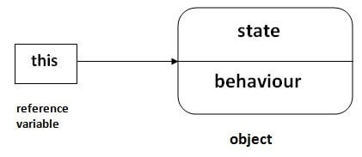
this Keyword
There can be a lot of usage of Java this keyword. In Java, this is a reference variable that refers to the current object.

Slide 7
this Keyword
Usage of Java this keyword
this can be used to refer current class instance variable.
this can be used to invoke current class method (implicitly)
this() can be used to invoke current class constructor.
this can be passed as an argument in the method call.
this can be passed as argument in the constructor call.
this can be used to return the current class instance from the method.

Slide 8
this Keyword
1) this: to refer current class instance variable
The this keyword can be used to refer current class instance variable.
If there is ambiguity between the instance variables and parameters, this keyword resolves the problem of ambiguity.
If local variables(formal arguments) and instance variables are different, there is no need to use this keyword like in the following program:
Example: without this
Example: with this

Slide 9
this Keyword
2) this: to invoke current class method
we may invoke the method of the current class by using the this keyword.
If we don't use the this keyword, compiler automatically adds this keyword while invoking the method.
Example: with this

Slide 10
this Keyword
3) this() : to invoke current class constructor
The this() constructor call can be used to invoke the current class constructor.
It is used to reuse the constructor.
In other words, it is used for constructor chaining.
Example: this
Example: this

Slide 11
this Keyword
4) this: to pass as an argument in the method
The this keyword can also be passed as an argument in the method.
It is mainly used in the event handling.
Application :
In event handling (or) in a situation where we have to provide reference of a class to another one.
It is used to reuse one object in many methods.
Example: this

Slide 12
this Keyword
6) this keyword can be used to return current class instance
We can return this keyword as an statement from the method. In such case, return type of the method must be the class type (non-primitive).
Example: this

Slide 13
main method
public static void main(String args[ ]) {
As a general rule, a Java program begins execution by calling main( ).
The public keyword is an access modifier, which allows the programmer to control the visibility of class members.
When a class member is preceded by public, then that member may be accessed by code outside the class in which it is declared.

Slide 14
main method
public static void main(String args[ ]) {
The keyword static allows main( ) to be called without having to instantiate a particular instance of the class.
This is necessary since main( ) is called by the Java Virtual Machine before any objects are made.
The keyword void simply tells the compiler that main( ) does not return a value.

Slide 15
main method
public static void main(String args[ ]) {
Any information that you need to pass to a method is received by variables specified within the set of parentheses that follow the name of the method.
These variables are called parameters.
If there are no parameters required for a given method, we still need to include the empty parentheses.
In main( ), there is only one parameter.
String args[ ] declares a parameter named args, which is an array of instances of the class String.

Slide 16
main method
public static void main(String args[ ]) {
One other point: main( ) is simply a starting place for your program.
A complex program will have dozens of classes, only one of which will need to have a main( ) method to get things started.

Slide 17
Static Block
Unlike C++, Java supports a special block, called static block (also called static clause) which can be used for static initializations of a class.
This code inside static block is executed only once: the first time the class is loaded into memory.
Static blocks are executed before constructors.
Example
Example

Slide 18
Instance Block
Instance Initialization Blocks or IIB are used to initialize instance variables .
So firstly, constructor is invoked and the java compiler copies the instance initializer block in the constructor after the first statement super().
They run each time when object of the class is created.
We can also have multiple IIBs in a single class.
Example

Slide 19
Instance Block
Important points:
Instance Initialization Blocks run every time a new instance is created.
Initialization Blocks run in the order they appear in the program
The Instance Initialization Block is invoked after the parent class constructor is invoked (i.e. after super() constructor call)

Slide 20
Static methods vs Instance methods
Instance Method
Instance method are methods which require an object of its class to be created before it can be called.
To invoke a instance method, we have to create an Object of the class in within which it defined.
These methods themselves are stored in Permanent Generation space of heap but the parameters (arguments passed to them) and their local variables and the value to be returned are allocated in stack.

Slide 21
Static methods vs Instance methods
Instance Method
They can be called within the same class in which they reside or from the different classes defined either in the same package or other packages depend on the access type provided to the desired instance method.
Example

Slide 22
Static methods vs Instance methods
Static Method
Static methods are the methods in Java that can be called without creating an object of class.
They are referenced by the class name itself or reference to the Object of that class.
Important Points:
Static method(s) are associated with the class in which they reside i.e. they are called without creating an instance of the class i.e ClassName.methodName(args).
They are designed with the aim to be shared among all objects created from the same class.

Slide 23
Static methods vs Instance methods
Important Points:
Static methods can not be overridden, since they are resolved using static binding by the compiler at compile time.
However, we can have the same name methods declared static in both superclass and subclass, but it will be called Method Hiding as the derived class method will hide the base class method.
Example

Slide 24
Object class in Java
There is one special class, Object, defined by Java.
All other classes are subclasses of Object. That is, Object is a superclass of all other classes.
This means that a reference variable of type Object can refer to an object of any other class.
Also, since arrays are implemented as classes, a variable of type Object can also refer to any array.

Slide 25
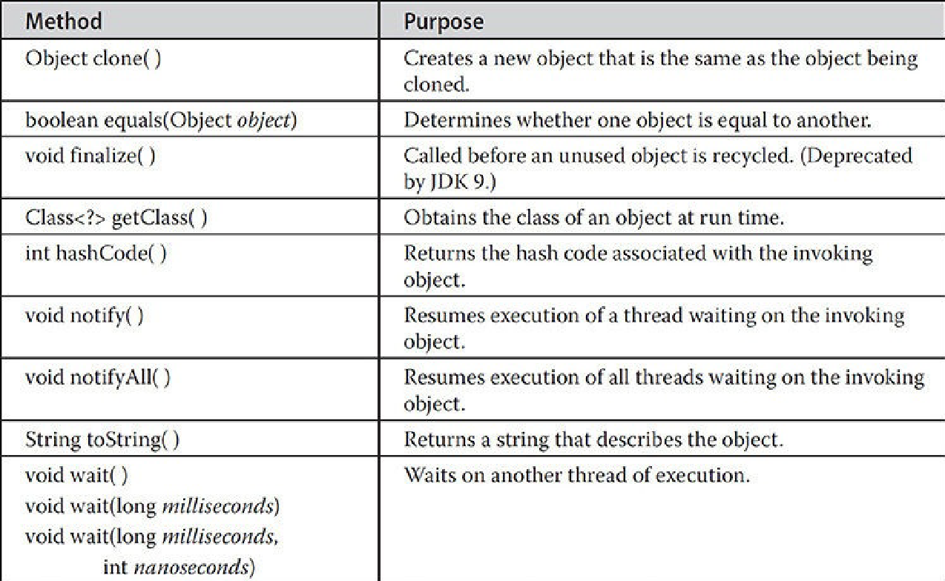
Object Class Methods

Slide 26
Object class in Java
toString() : toString() provides String representation of an Object and used to convert an object to String.
The default toString() method for class Object returns a string consisting of the name of the class of which the object is an instance, the at-sign character `@’, and the unsigned hexadecimal
Example

Slide 27
Object class in Java
getClass() : Returns the class object of “this” object and used to get actual runtime class of the object.
It can also be used to get metadata of this class.
The returned Class object is the object that is locked by static synchronized methods of the represented class.
As it is final so we don’t override it.
Example

